Slide 1
Analysis on Chinook_db

Slide 2
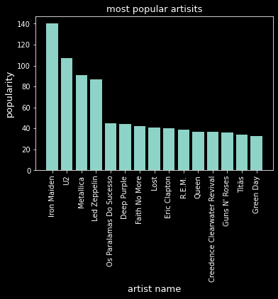
Top purchased artists
Iron maiden looks very popular with the customers
he is the one to go if you want to produce an album to get the most revenue out of it.

Slide 3
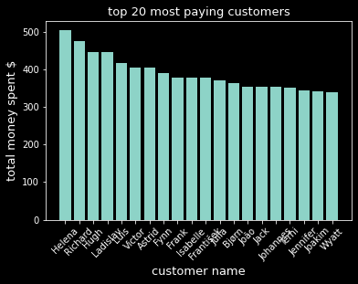
Top paying customers
Helena, Richard, Hugh, and Ladislav are the most paying customers in total in our data base
We should send them gifts or put their names on the wall on our store to encourage such a behavior

Slide 4
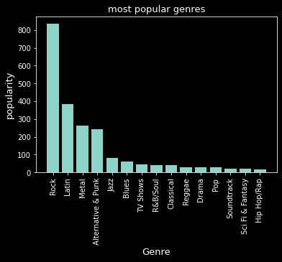
Top genres
ROCK is the most popular among customers.
If we are looking to do some promotions ROCK Genre is the best and most stable to do promotions.

Slide 5
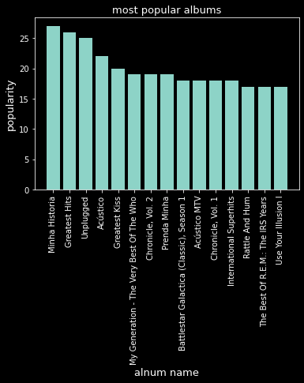
Top albums
The most overall purchased albums are minha historia form Chico Buarque, greatest hits from Lenny Kravitz, and unplugged from Eric Clapton
Although the artists aren’t the most popular , the albums are requested alot

